Slide 1

Final Presentation On
Software Project Lab II
By Team Twins
Project Name : IIT Library
22/09/2022
IIT Library
01

Slide 2
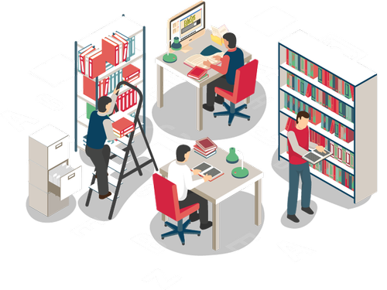
Supervised By
Dipok Chandra Das
Assistant Professor
Institute of Information Technology
Noakhali Science and Technology University
12/06/2022
IIT Library
02
22/09/2022

Slide 3
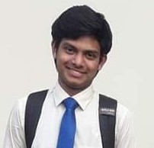
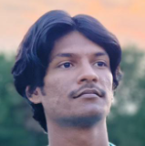

Our Team Style
ASH1825042M
1
ratna2514@student.nstu.edu.bd
facebook.com/ratnoTripuraa
Prosanto Deb
2
Ratna Kumar Tripura
Abdullah Alif
ASH1925005M
prosanto2514@student.nstu.edu.bd
ASH1925009M
facebook.com/prosantoDEB
alif2514@student.nstu.edu.bd
3
facebook.com/abdullah.alif.9210
22/09/2022
IIT Library
03

Slide 4
Table of Contents
01
02
03
04
05
06
Introduction
Objective
Stakeholders
Features
User Interface
Future Work
22/09/2022
IIT Library
04

Slide 5
Introduction
Introducing “IIT Library” that provides a hassle-free system. Using this system, we can easily borrow books and return them within a specific period. To manage membership, the system has a unique registration process for each individual authentic member of the IIT Library. Using this system, the users can easily search the books in the library. Moreover, the system calculates the fine due for non-return book and also get electronic copies of the books if they are available.
22/09/2022
IIT Library
05

Slide 6
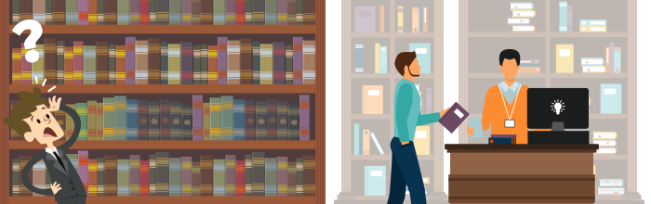
Objective
Transforming Manual to Automated Library System
22/09/2022
IIT Library
06

Slide 7
Stakeholders
Change Control Board
Suppliers
Individuals and teams that are part of the
organization that develops the software product – Team Twins, IIT, NSTU
Responsible for reviewing or proposing changes, approving/disapproving changes, ensuring that approved changes are implemented and validated – Faculty Members, IIT, NSTU
Acquirer
Customers who request, purchase, and/or pay for the software product – IIT NSTU
End-users who actually use the product directly or indirectly – Students, Teachers, Officers and Staff
22/09/2022
IIT Library
07

Slide 8
Features
Advanced Booking and Electronic Copy of Books
Searching Books
Fine Management
Membership Management
Borrow and Returning Books
22/09/2022
IIT Library
08

Slide 9
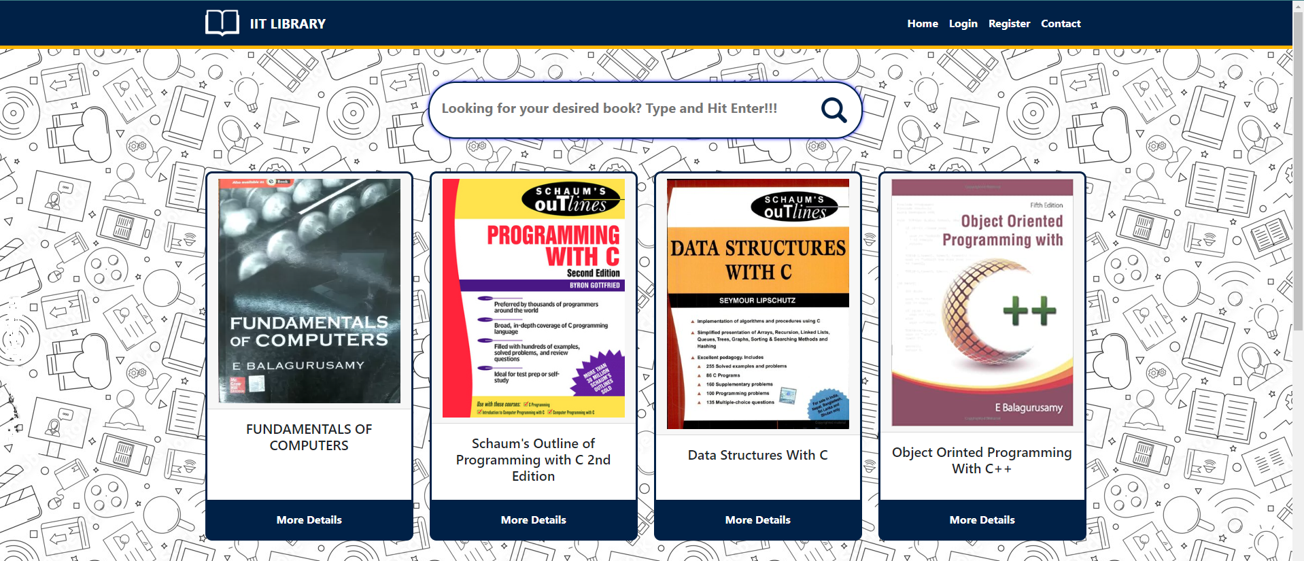
Home Page
(User)
22/09/2022
IIT Library
09

Slide 10
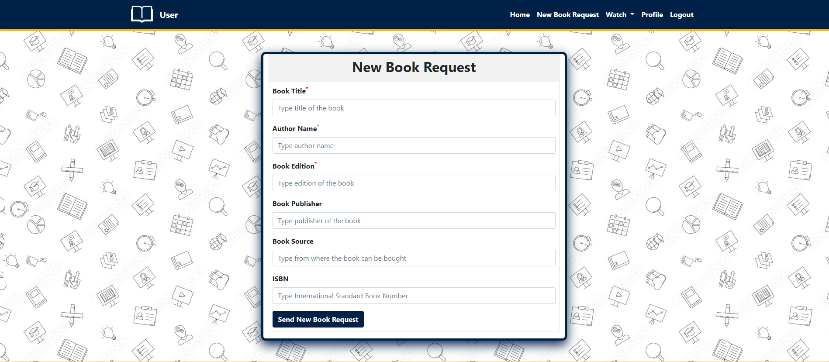
Book Request
(User)
22/09/2022
IIT Library
10

Slide 11
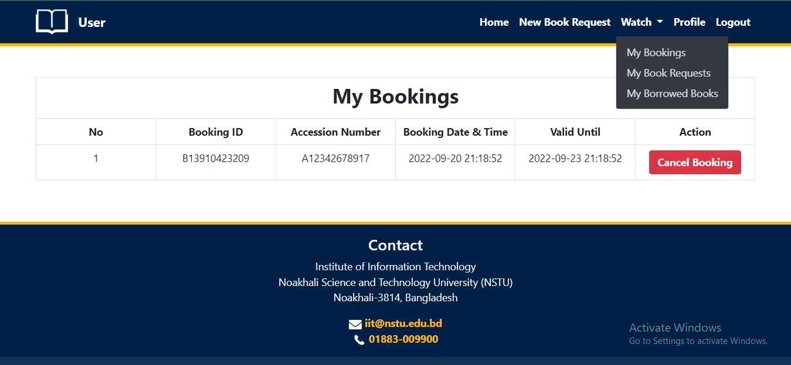
My Booking
(User)
22/09/2022
IIT Library
11

Slide 12
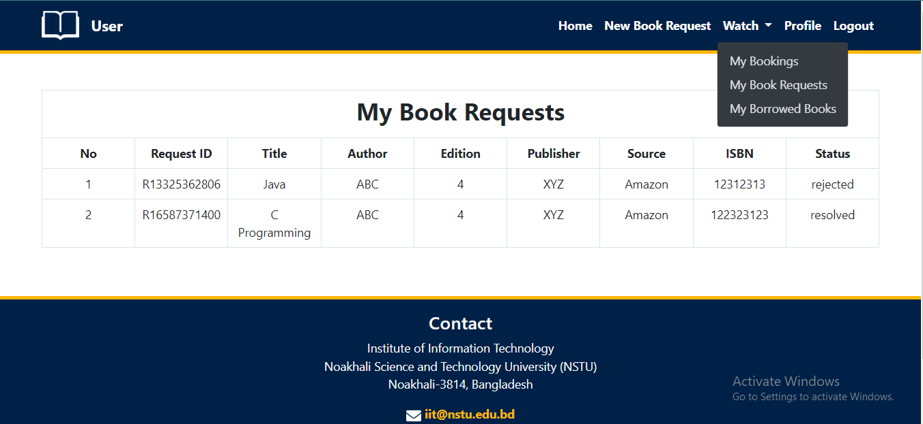
New Book Request
(User)
22/09/2022
IIT Library
12

Slide 13
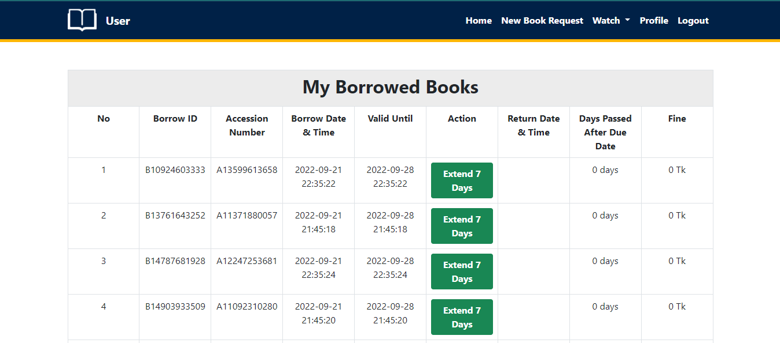
My Borrowed Books
(User)
22/09/2022
IIT Library
13

Slide 14
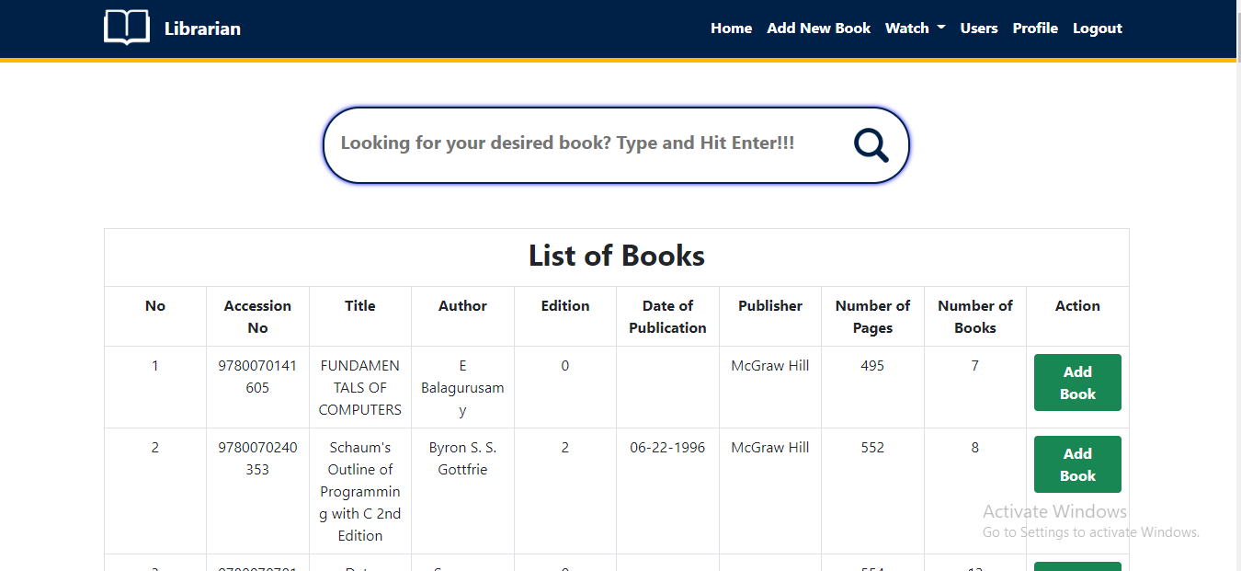
List of Books
(Librarian)
22/09/2022
IIT Library
14

Slide 15
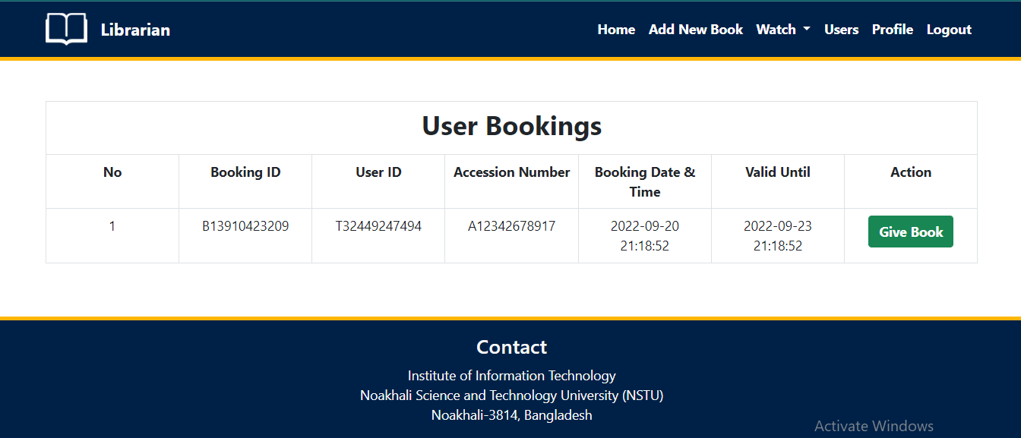
User Booking
(Librarian)
22/09/2022
IIT Library
15

Slide 16
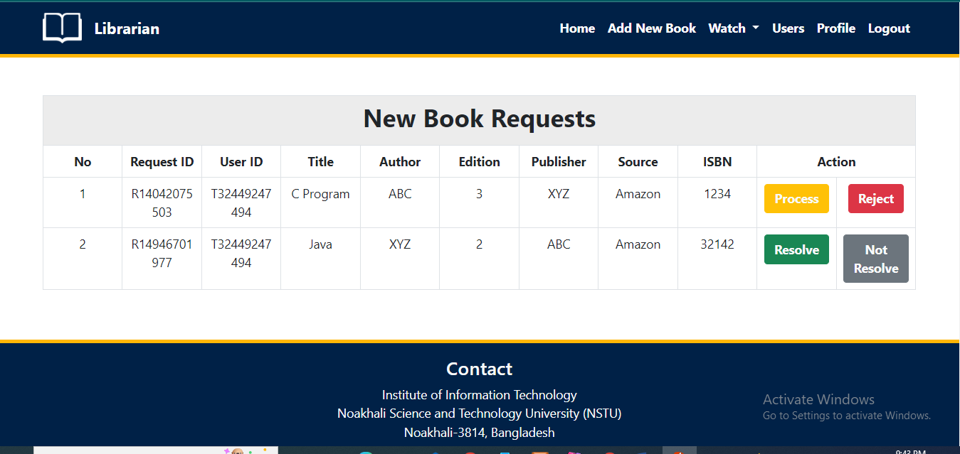
New Book Request
(Librarian)
22/09/2022
IIT Library
16

Slide 17
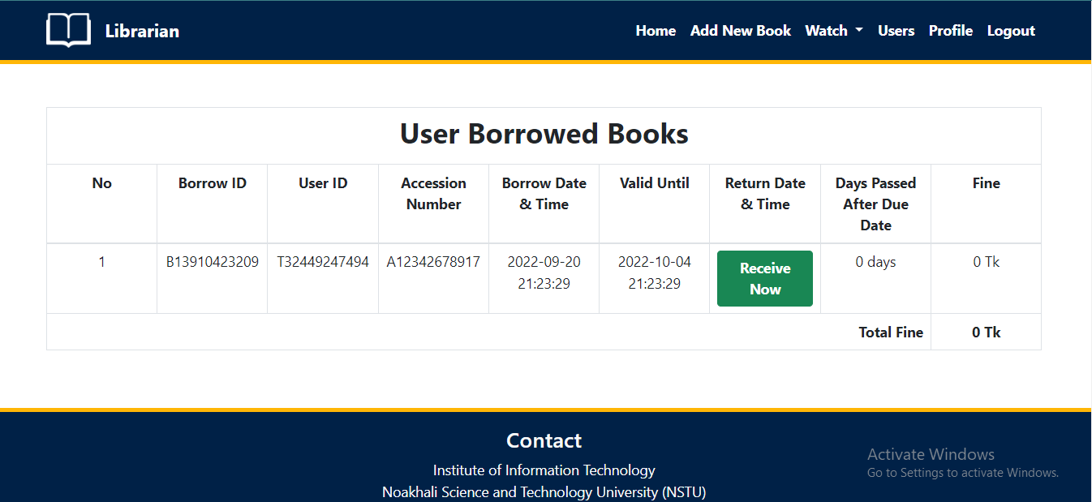
User Borrowed Books
(Librarian)
22/09/2022
IIT Library
17

Slide 18
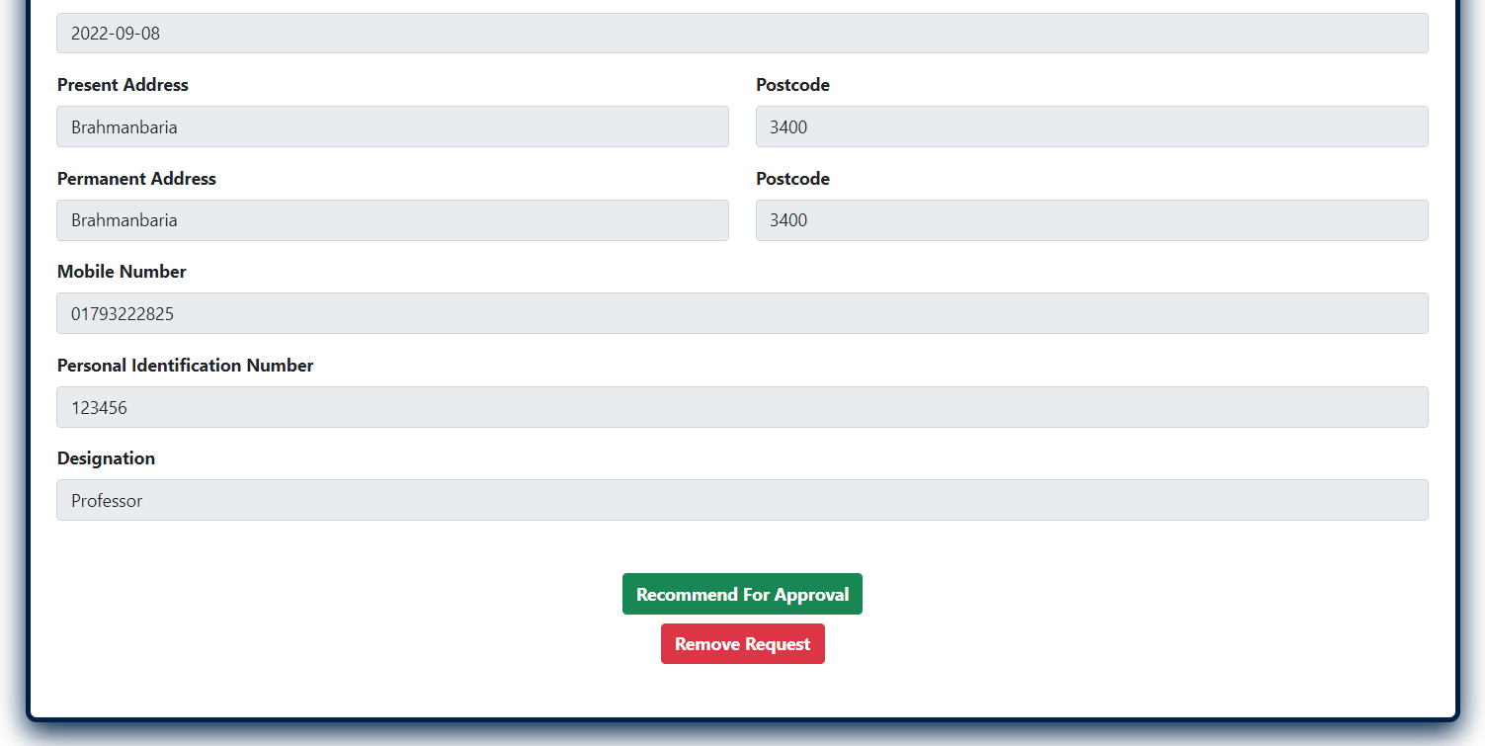
User Approve Request
(Librarian)
22/09/2022
IIT Library
18

Slide 19
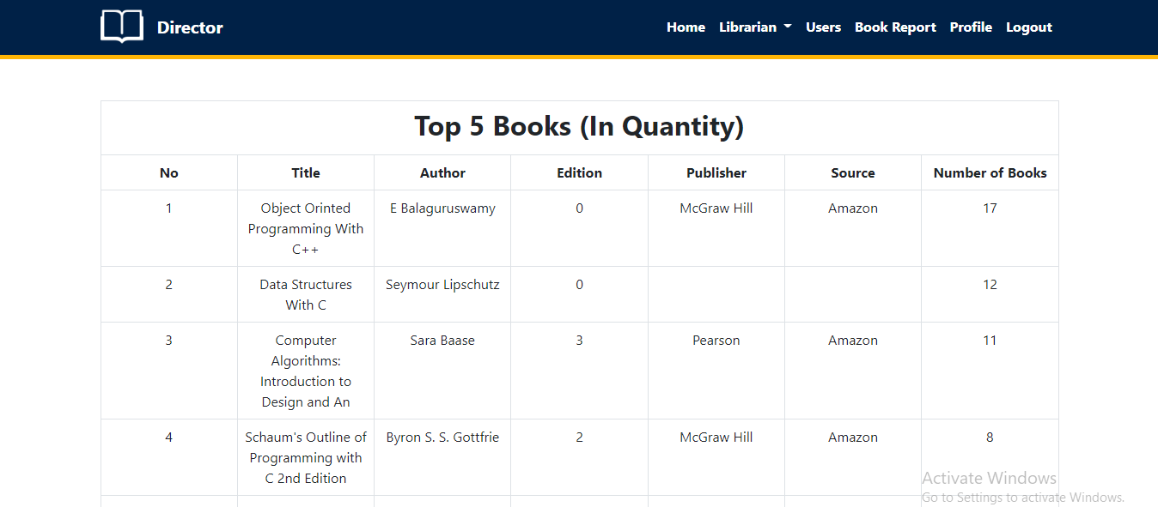
Home Page
(Director)
22/09/2022
IIT Library
19

Slide 20
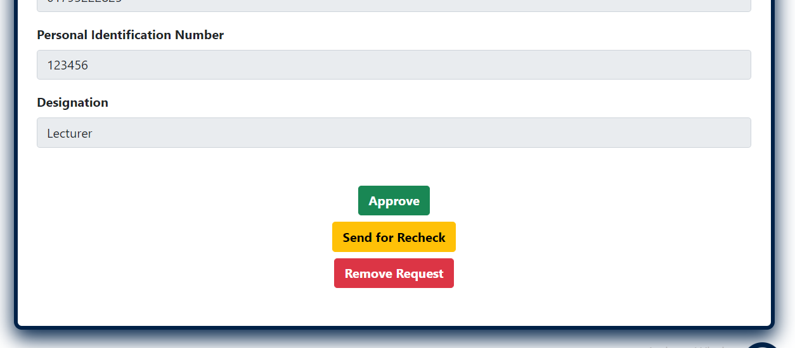
User Approval
(Director)
22/09/2022
IIT Library
20

Slide 21
Future Work
01
02
Sending Text Message as Response
Implementing Payment Gateway for receiving fine
03
Implementing Barcoding System
Generating Library Card
04
22/09/2022
IIT Library
21

Slide 22
Team Contribution
Module Name | Member
Home Page, Book Info, Borrow Book, Booking, Book Request Handling, Profile Update | Prosanto Deb
Login, Register, Add New Book, Add User, Add or Remove Librarian, Watch Book Requests. | Abdullah Alif
Register Page (Front end), Header, Footer, Creating Tables, User Details (Front end) | Ratna Kumar Tripura
System Integration
The process of bringing together the component sub-systems into one system.
- Done By Prosanto Deb
01
02
04
03
Testing and Debugging
Prosanto Deb
Abdullah Alif
Slide Preparation
Prosanto Deb
Abdullah Alif
Ratna Kumar Tripura
22/09/2022
IIT Library
22

Slide 23
Thank You
22/09/2022
IIT Library
23

